Slide 1


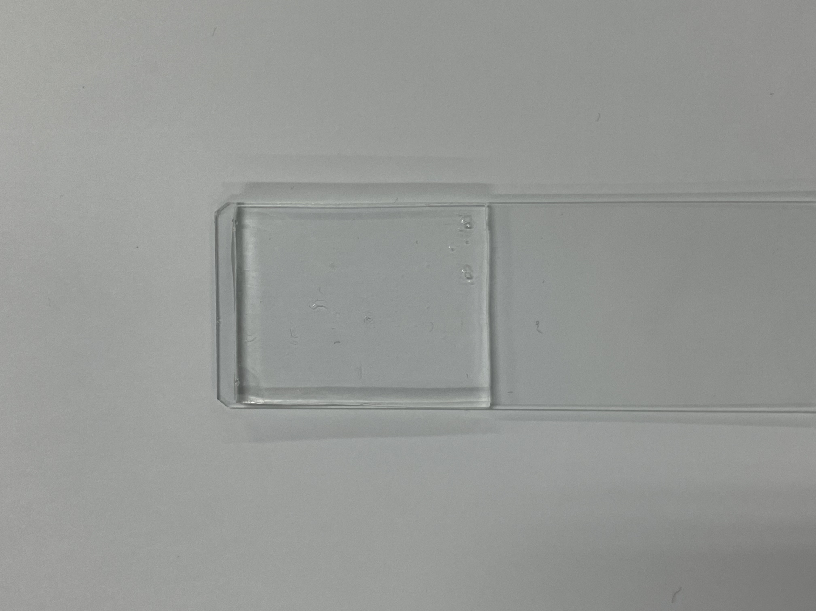
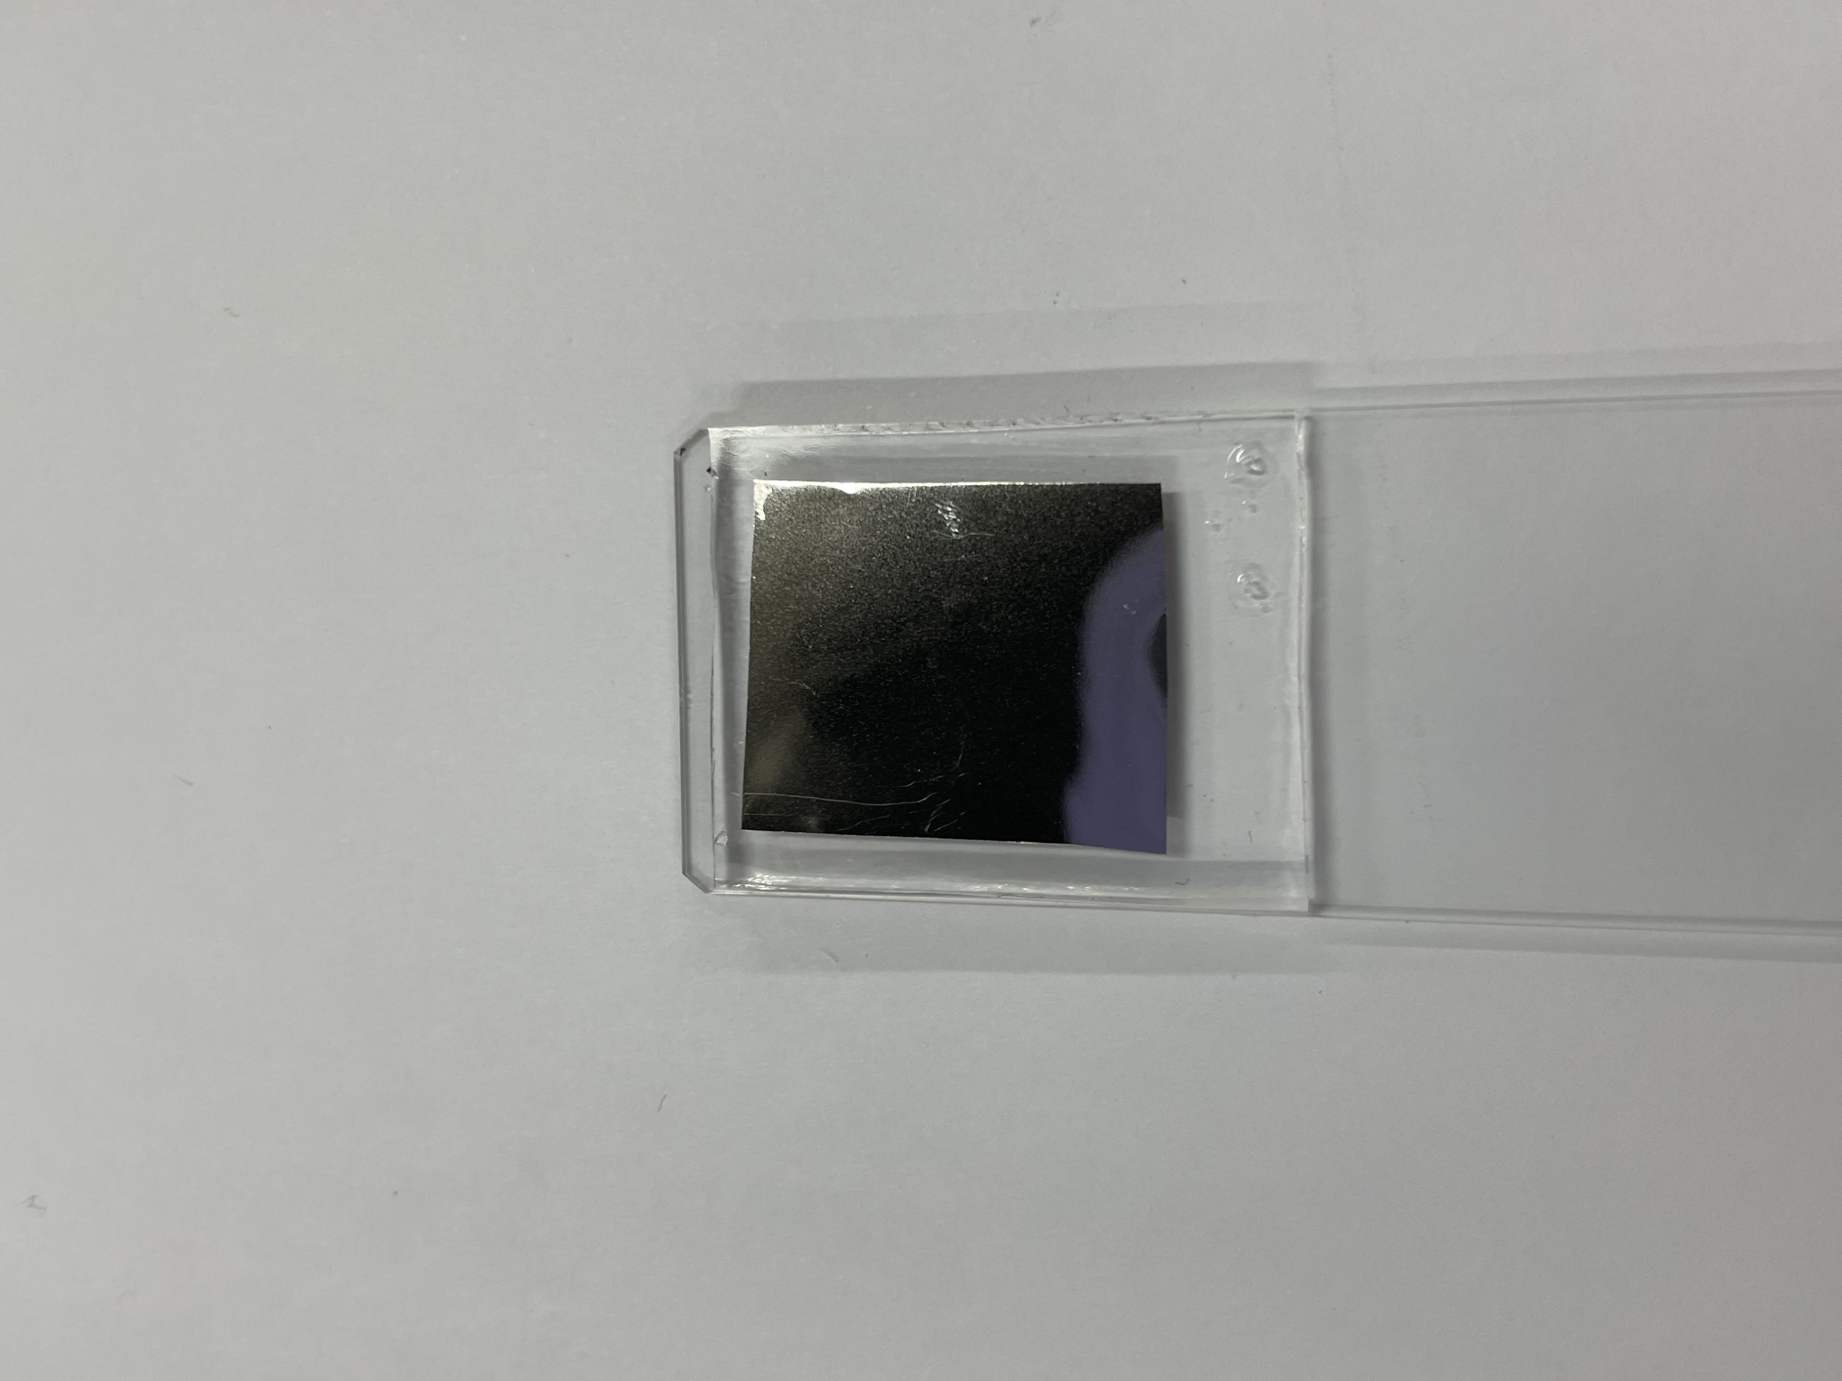
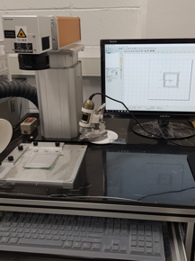
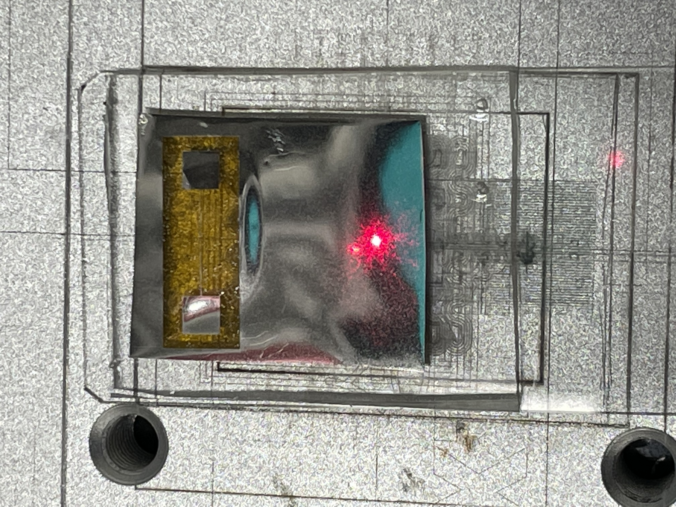
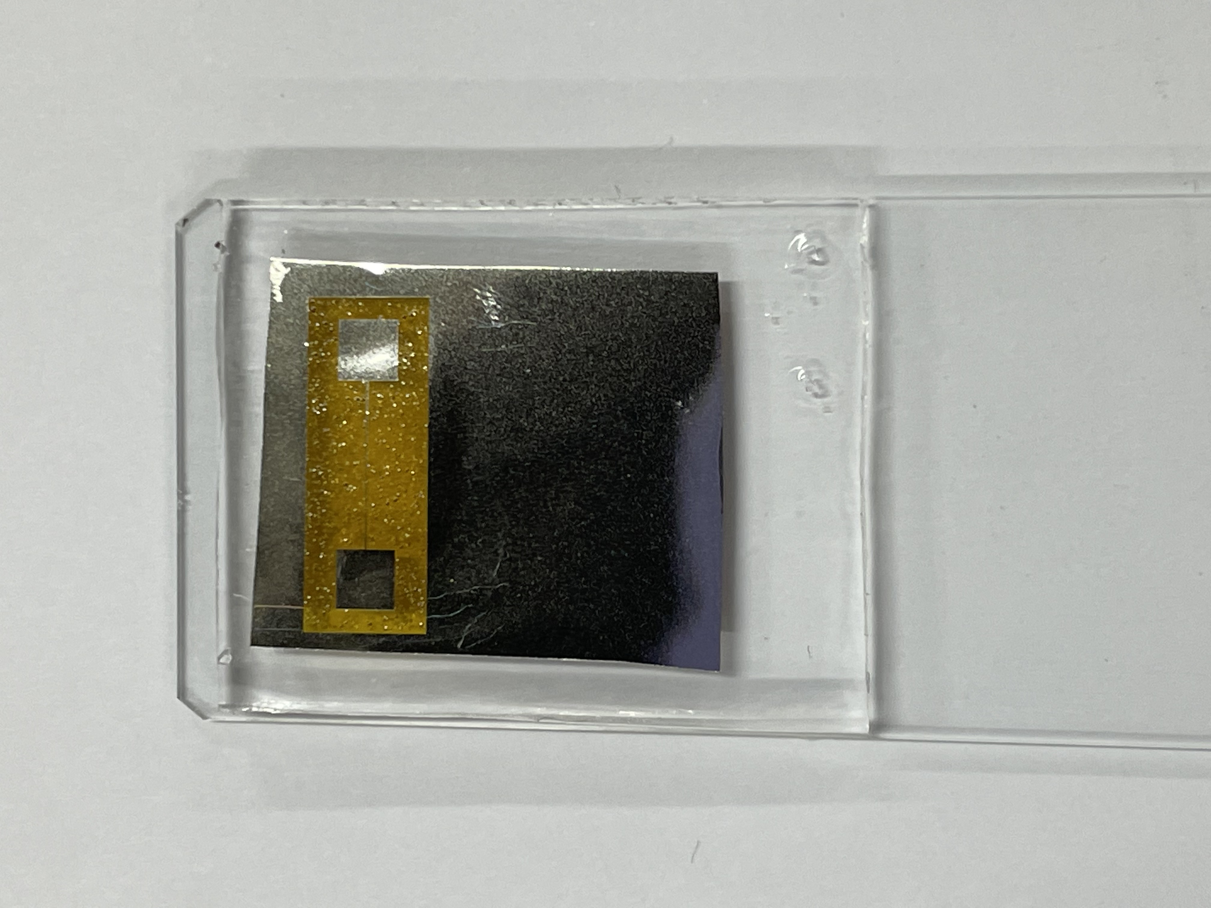
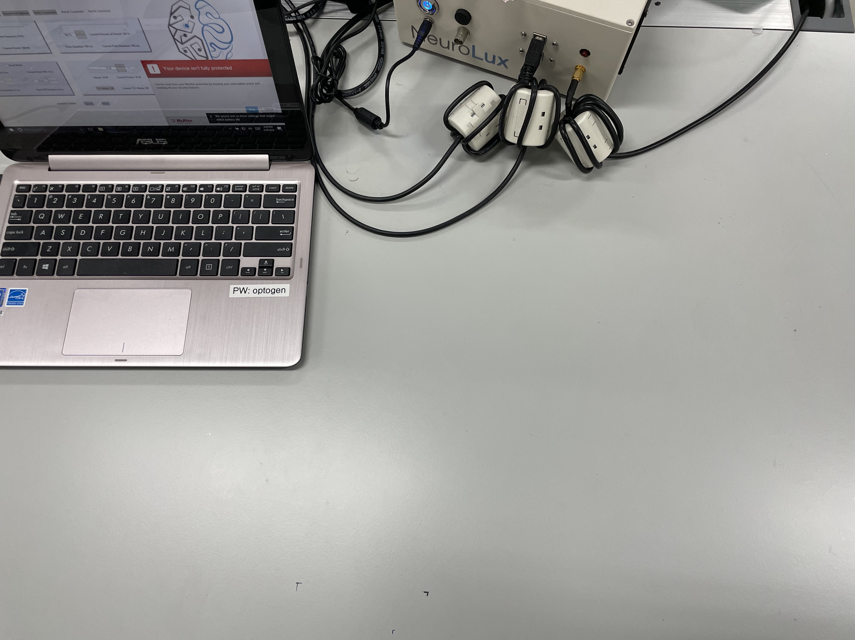
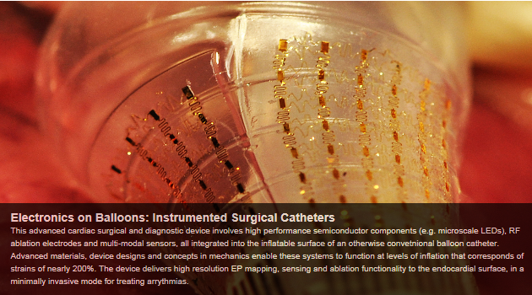
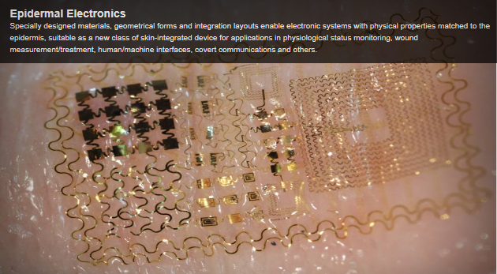
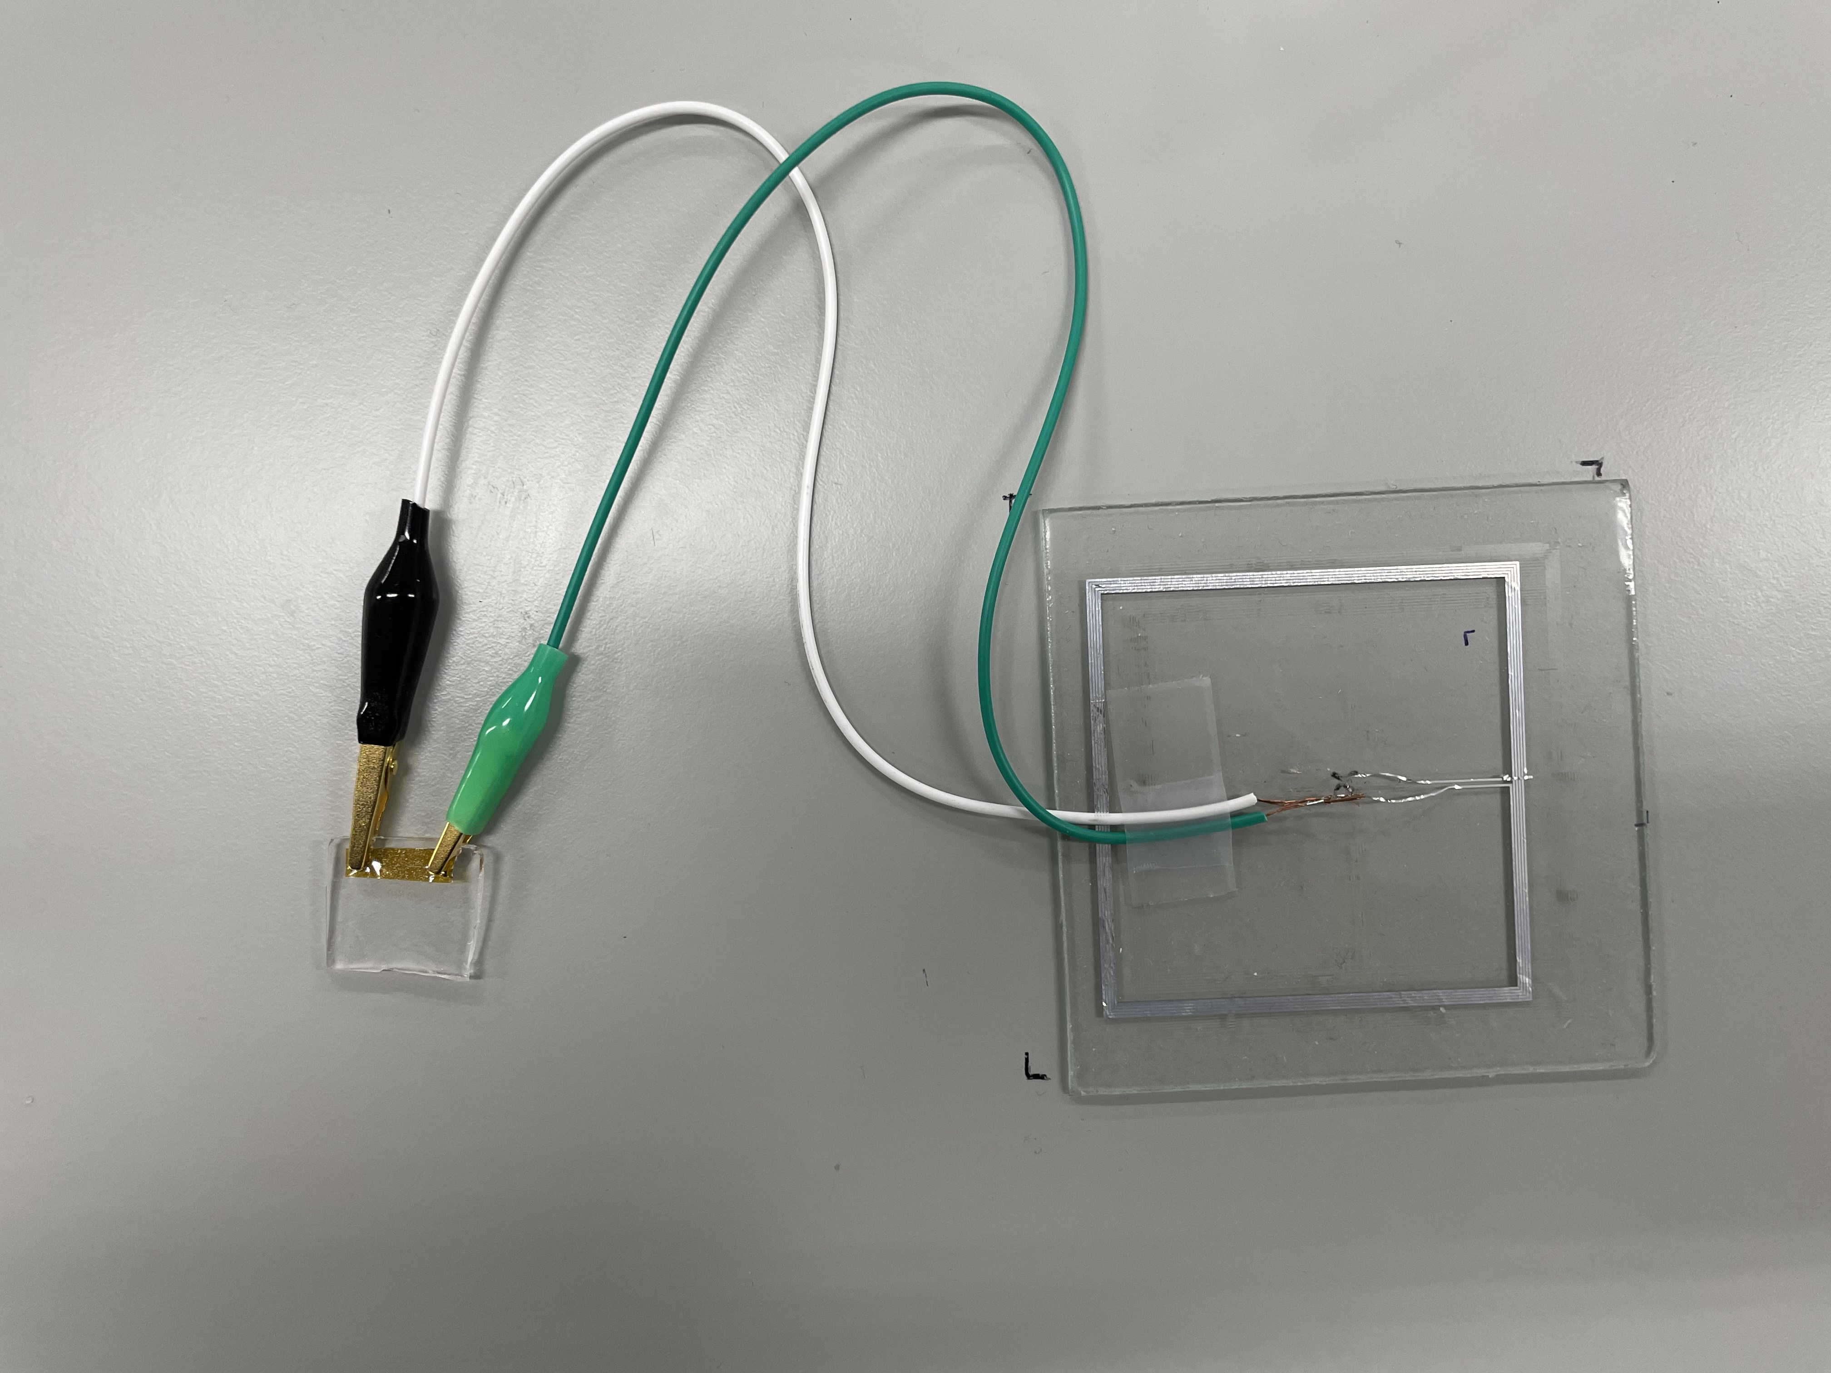
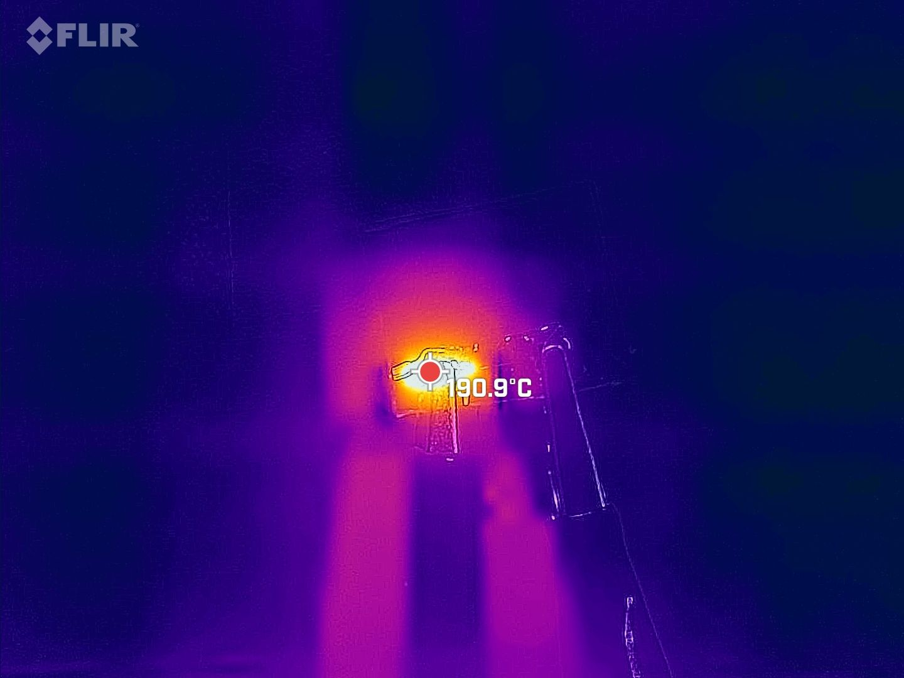
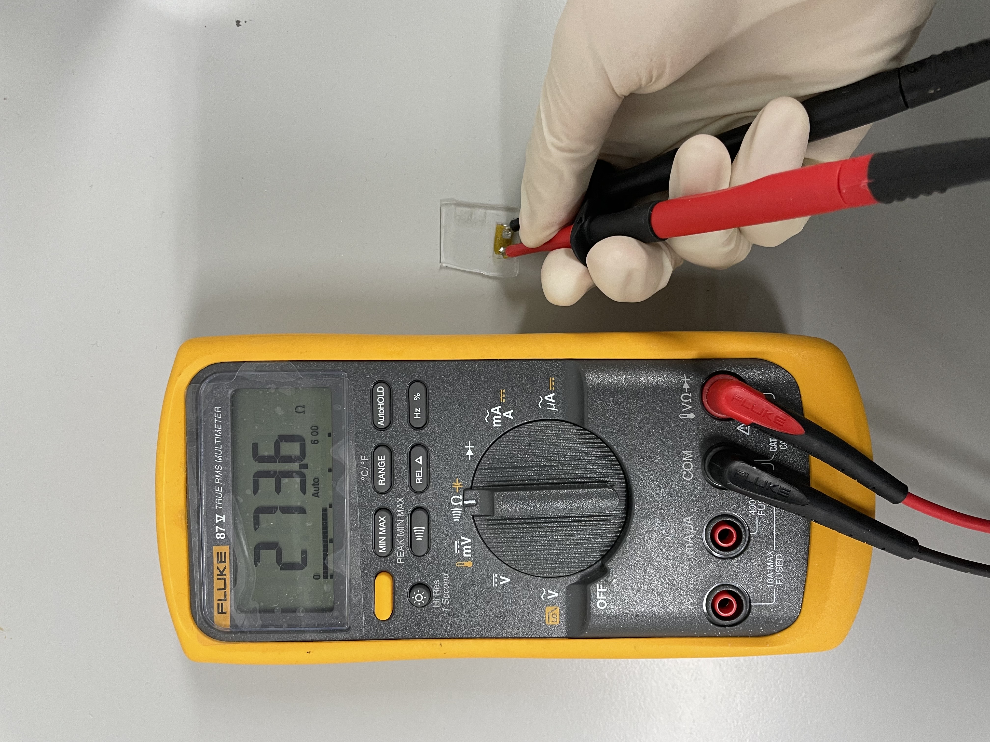
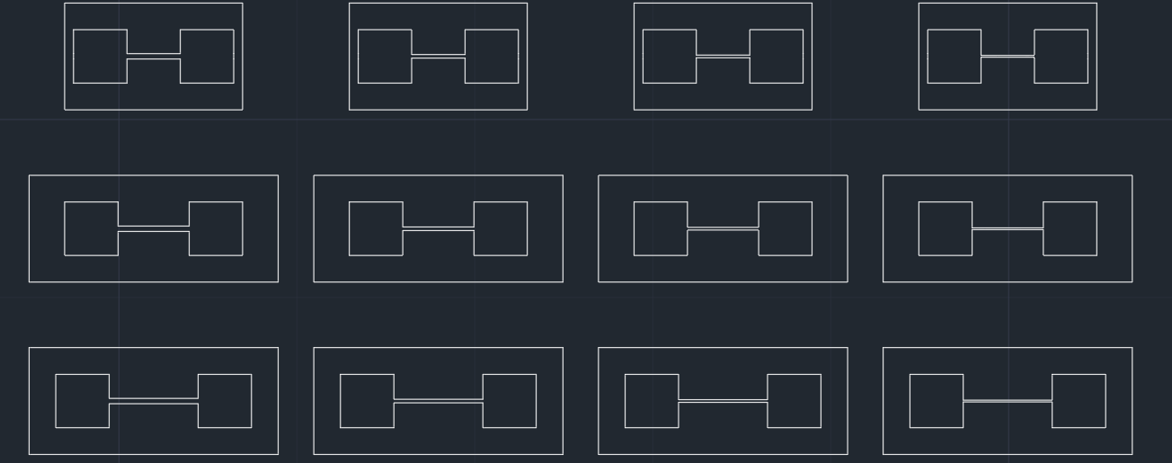
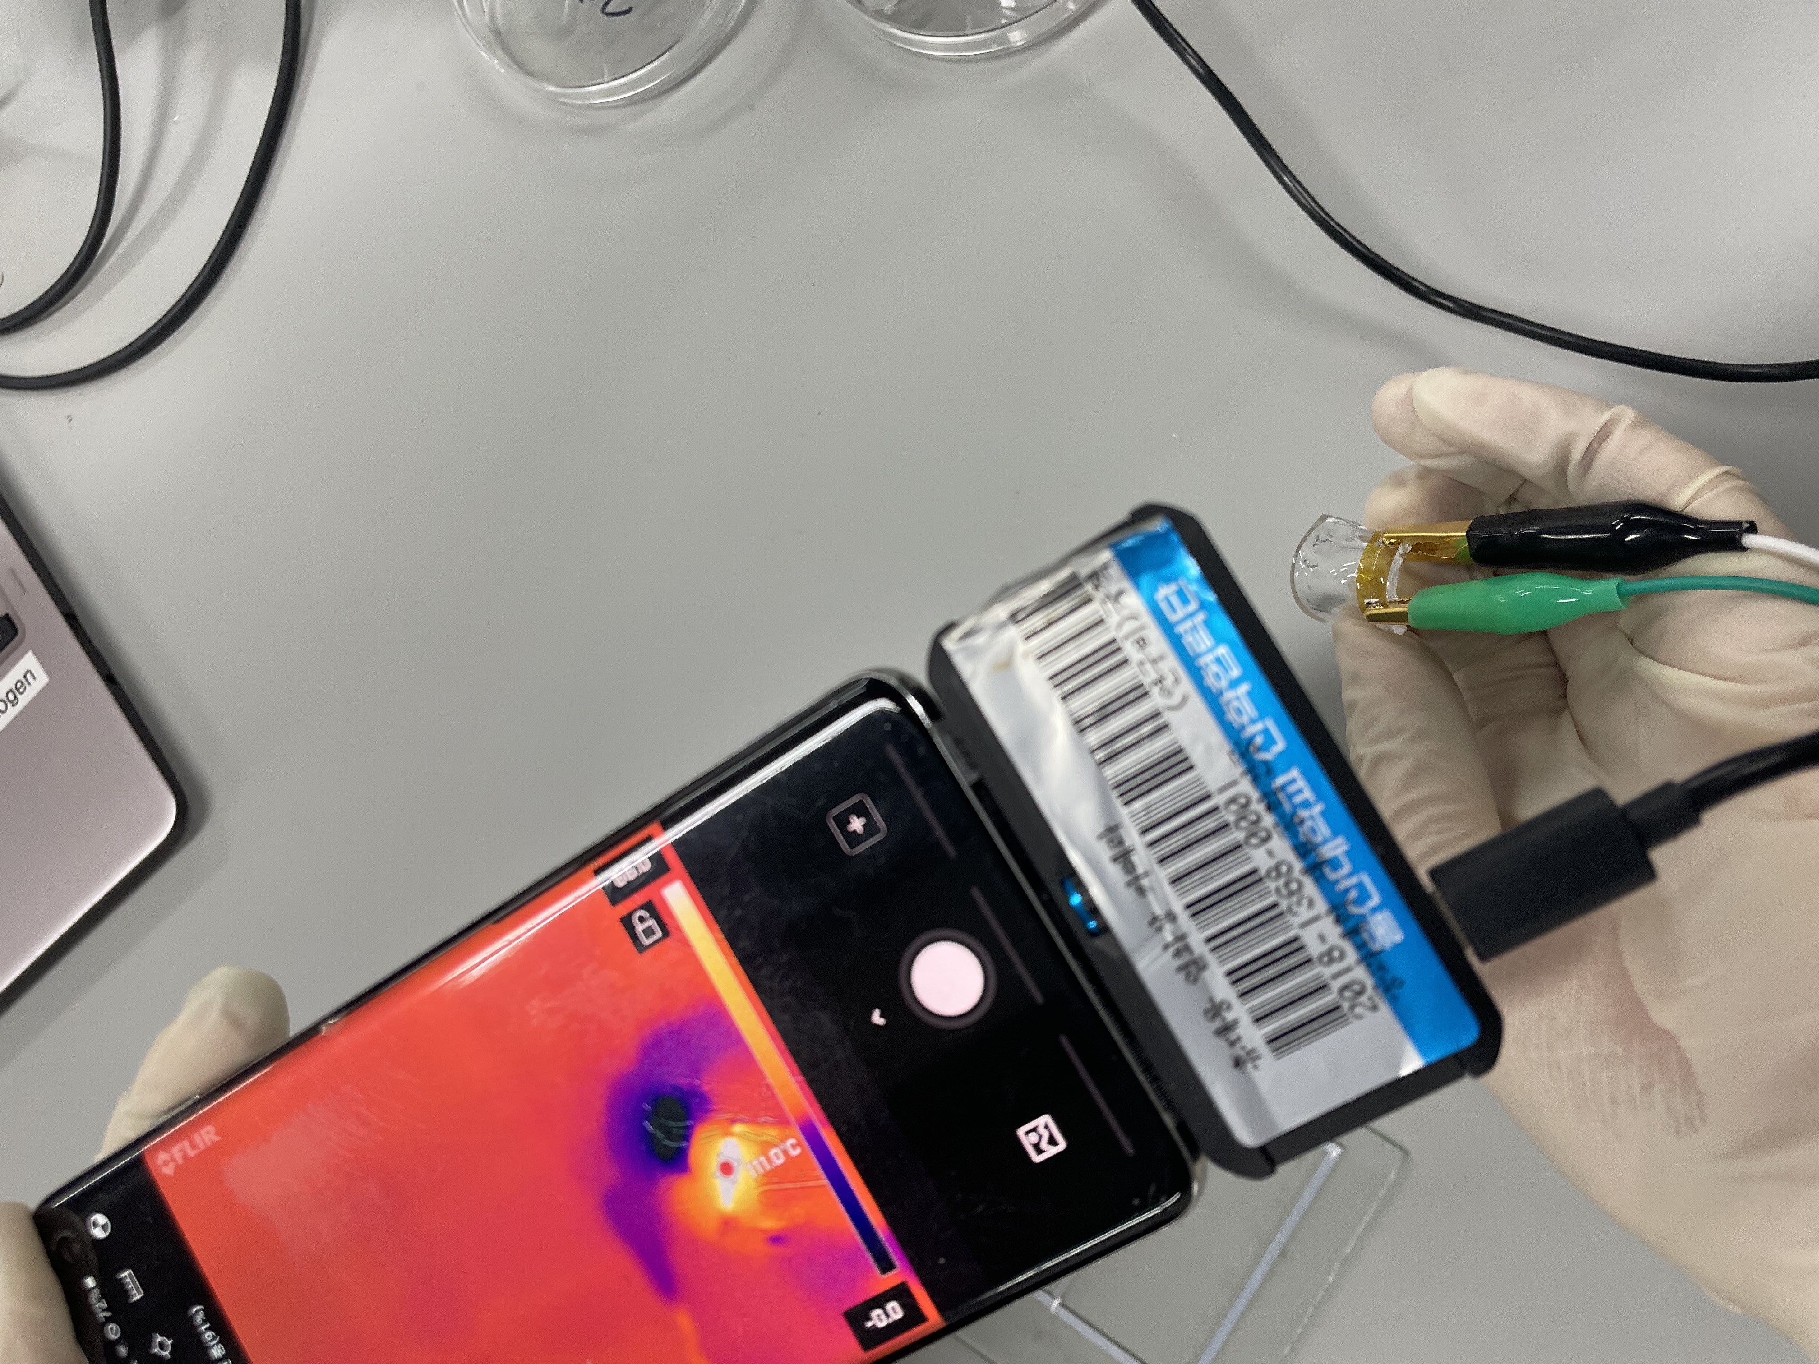
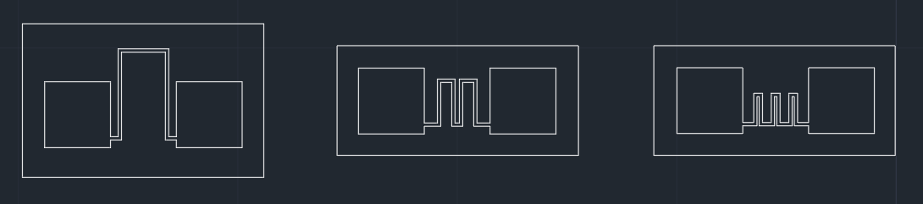
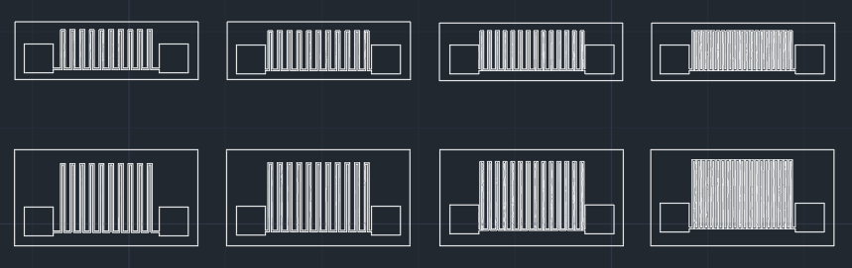
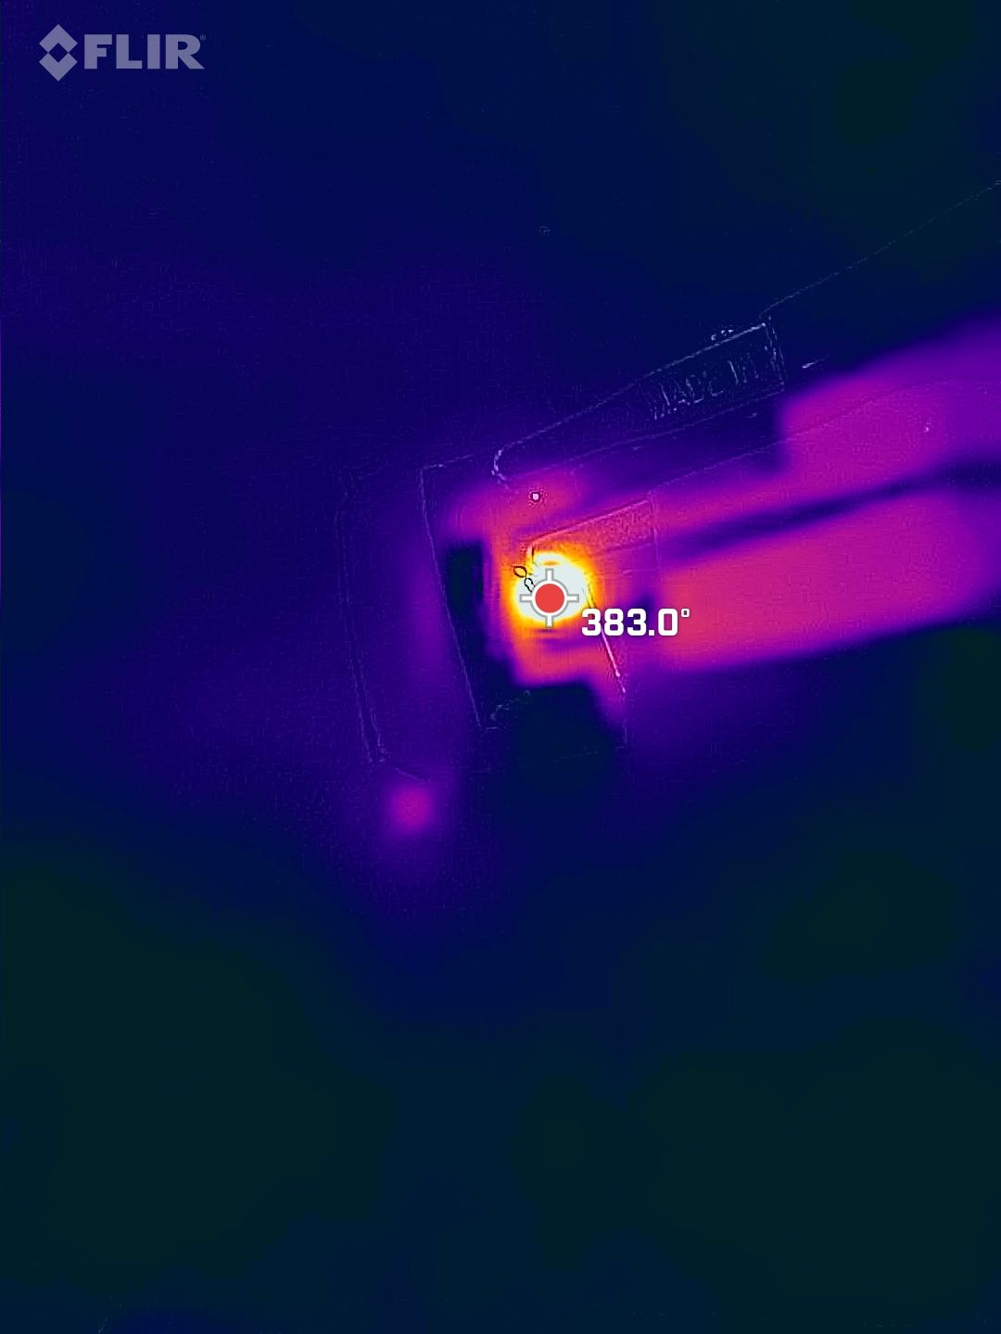
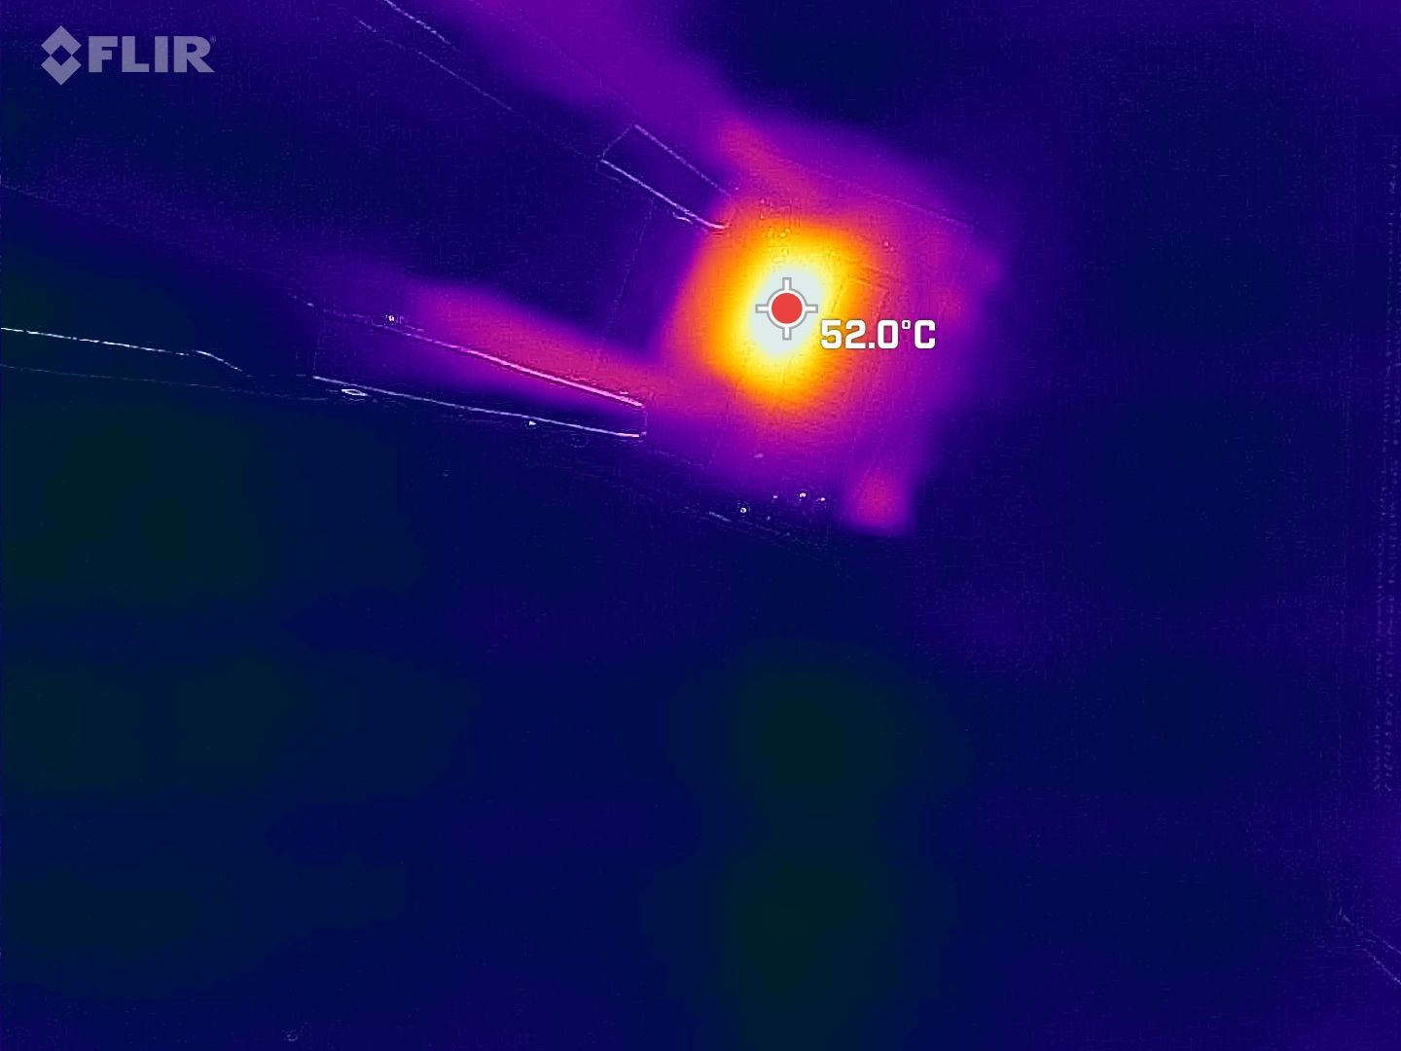
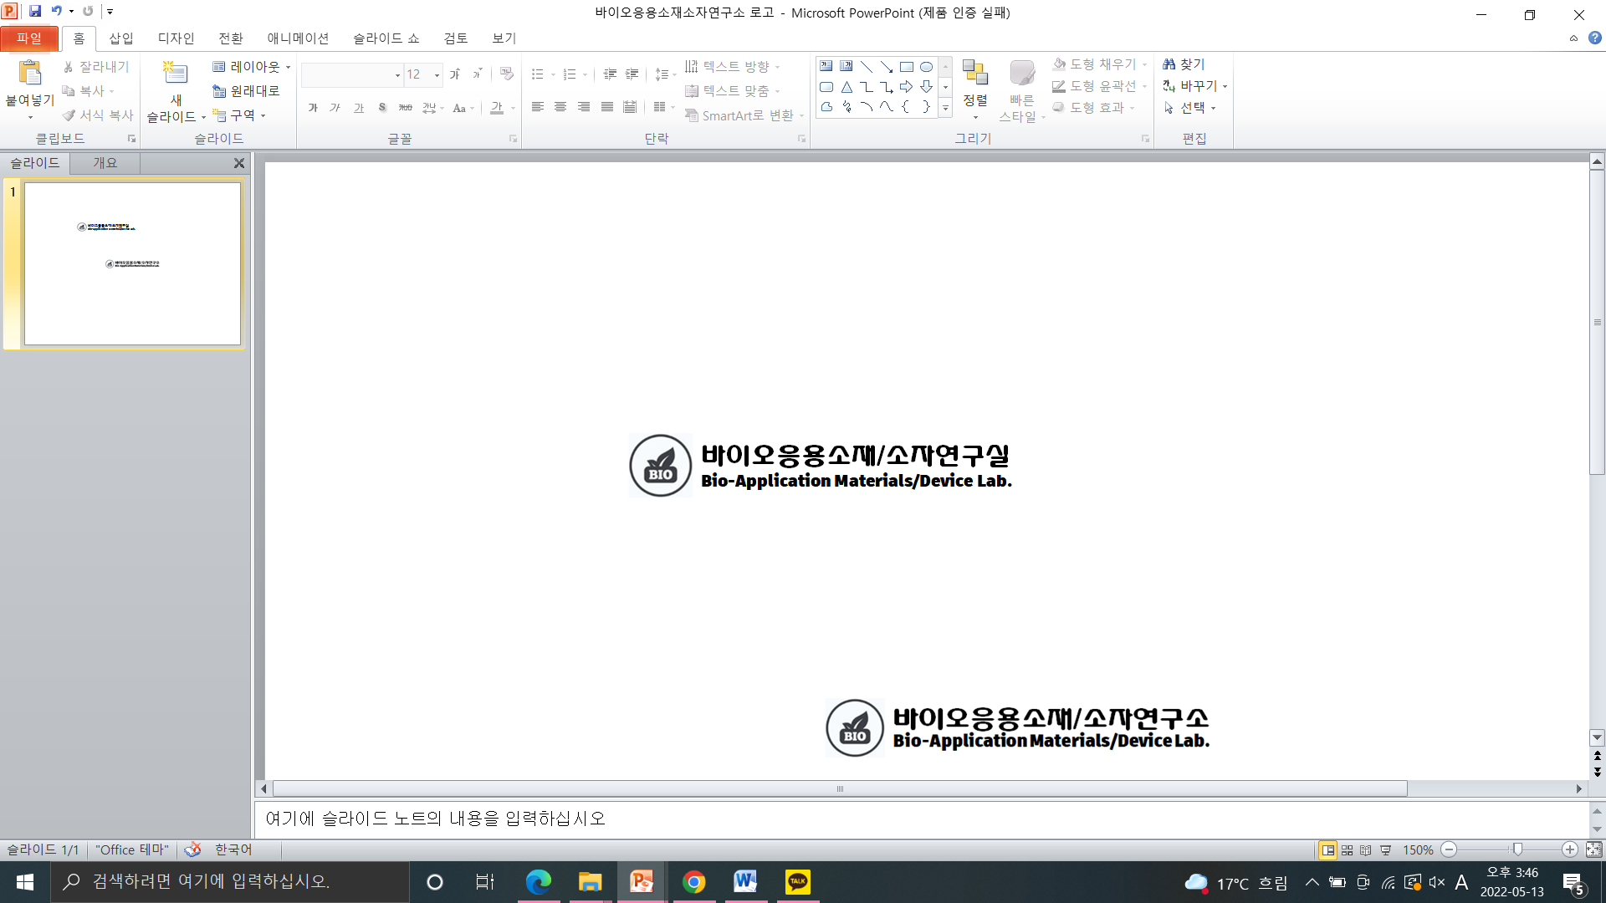
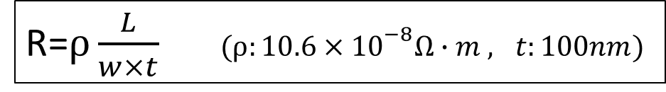
Micro-heater designs for wireless electronic devices
Sangho Park and Gunchul Shin
School of Materials Science & Engineering, , University of Ulsan, Korea
Abstract
Experiments
Micro-heater(MH) are key components of micro-sensors, such as micro-electronic components and gas sensors and humidity sensors. Internet of Things (IoT) adoption is increasing in daily life, including automobiles and home appliances, and Micro Electro Mechanical Systems (MEMS) and sensors have become key components for them. This development of MEMS requires low power and high efficiency of micro-heaters. Micro-heater characteristics are affected by heater design, applied voltage/current, type and amount of heater material. Among them, we adjusted the structure/design of the heater to improve its performance. Our heater and antenna operate wirelessly and are flexible to allow for free deformation.
1. Multi-layer Structure of Micro-heaters
Layers of Device:
Pt(100 nm)/Ti(10 nm), Polyimide(PI, 30um)/ Polydimethylsiloxane(PDMS, 30um)/Glass
Pt
Ti
Polyimide
Polyimide
PDMS
PDMS
2. Procedures of Micro-heater fabrication
PDMS on Glass
PDMS on multi-layer
laser marking system
Laser cutting
3. Wireless system
Introduction
RF signal generator
RF signal generator operate →13.56MHz radio Frequency
MEMS advantages
miniaturization, low power consumption, high performance
Application
sensors, microphones, medical devices, wearable devices
Transmitting Antenna region
The antenna Wirelessly receives power
4. Measurement of resistance and heat generation
The MH is connected to the wireless Al antenna.
The antenna is driven by a wireless power transmission device of Near field communication (NFC).
Using IR camera , Digital multimeter.
http://rogersgroup.northwestern.edu/
Results & Discussion
Single-line design
Single-line design
Length and width of metal wire
Length of metal wire
Pad size : 3x3mm.
The wire length :3,4,5 mm
The width : 0.3,0.2,0.15,0.10mm
R=$ρ\frac{L}{w×t} (ρ:10.6×{10}^{−8}Ω∙m , t:100nm)$
The wire length : 5mm to 15mm by 1mm.
The width was fixed to 0.15mm, which was the most heated.
Flexible heater
The longer the length , Narrower the width → the higher the resistance and temperature.
A width of 0.1mm has a high defect rate.
Optimal Length: 11mm.
Meander design
Change the number of bends to the same length
Variation of density in the same area
The horizontal length : 11 mm
The vertical height was fixed at 4mm and 7mm.
The total length of the wire : 11mm
The spacing between the pads was set to 3 mm
The higher the density → the lower the temperature.
Heated in a large area
The higher the number of bends → the higher temperature.
But resistance has been lowered.
Conclusion
In this study, we designed a flexible micro-heater that operates using NFC-based wireless power.
The temperature was highest when the heater was 11mm length and 0.15mm width.
The more bending, the higher the temperature.
The higher the density of the pattern, the lower the temperature.
Acknowledgments
This work was supported by the National Research Foundation of Korea (KRF), grant number 2021R1A41031644.

